Slide 1

Introduction to Object-Oriented Programming (OOP)
A Simple Guide for Students London Metropolitan University | 2024/25

Slide 2
What is Object-Oriented Programming (OOP)?
OOP organizes code using objects and classes.
Objects contain properties (data) and methods (actions).
OOP makes programs organized, reusable, and easy to manage.

Slide 3
Example of a Class in C#
Class = A blueprint for objects.
Object = an actual instance of a class.
Example: A Car class can have multiple car objects.

Slide 4
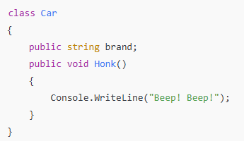

Example of a Class in C#

Slide 5
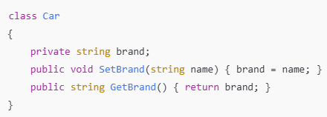
Encapsulation (Hiding Data)
Encapsulation hides details and protects data.
We use private to restrict access and public to allow access.

Slide 6

Inheritance (Reusing Code)
Inheritance lets one class reuse another class’s code.
Example: A Car class inherits from a Vehicle class.

Slide 7
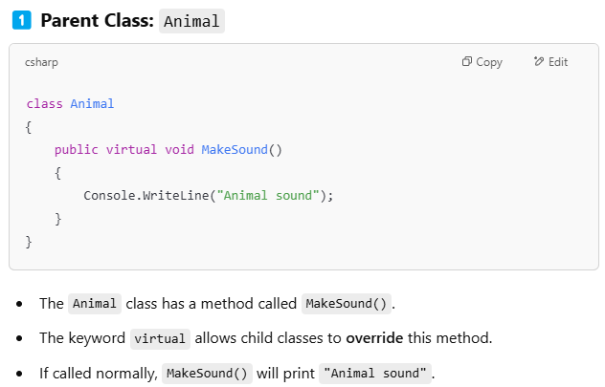
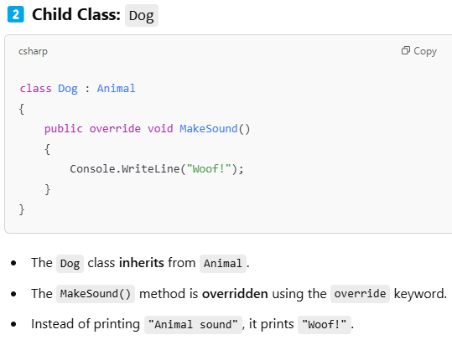
Polymorphism (Different Behavior)
Polymorphism lets child classes modify parent class methods.

Slide 8
Real-World Example
interface IVehicle
{
void Drive();
}
class Car : IVehicle
{
public void Drive() { Console.WriteLine("Car is driving!"); }
}
class Bicycle : IVehicle
{
public void Drive() { Console.WriteLine("Bicycle is pedaling!"); }
}

Slide 9
Summary (Key Takeaways)
✅ OOP organizes code into objects and classes.
✅ Encapsulation protects data using private and public.
✅ Inheritance reuses code from parent classes.
✅ Polymorphism allows different behaviors for the same method.
✅ Interfaces define a contract for classes to follow.

